Slide 1
AWS Honolulu User Group
Relational Databases in AWS
2018-06-07 – 3rd Meetup

Slide 2
Agenda
Why do we want DBs in the cloud?
AWS Relational Database Service (RDS)
Available DBs in AWS
AWS Aurora

Slide 3
Why do we want DBs in the cloud?
No more maintenance and patching!!!
Scalability
Specialized Expertise
Easy Failover
Migration tools (ie. Oracle => MySQL)
Improved Security
Disposables
Cost

Slide 4
AWS Relational Database Service (RDS)
Amazon Relational Database Service (Amazon RDS) makes it easy to set up, operate, and scale a relational databases in the cloud.
It provides cost-efficient and resizable capacity while automating time-consuming administration tasks such as hardware provisioning, database setup, patching and backups.
It frees you to focus on your applications so you can give them the fast performance, high availability, security and compatibility they need.

Slide 5
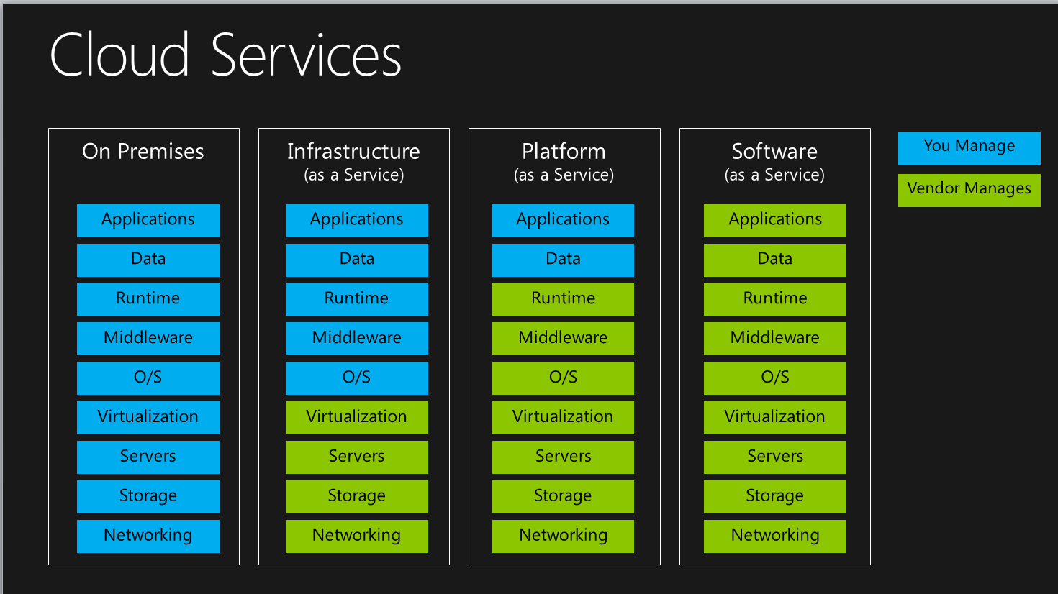
What kind of service are we looking at?
PaaS or DBaaS

Slide 6
Available DBs in AWS
PostgreSQL
MySQL
MariaDB
Oracle
MS SQL Server
AWS Aurora

Slide 7
AWS Aurora
Amazon Aurora is a MySQL and PostgreSQL compatible relational database built for the cloud, that combines the performance and availability of high-end commercial databases with the simplicity and cost-effectiveness of open source databases.
AWS DB (tuned MySQL and PostgreSQL)
Serverless DB (auto scaling)
High Available, Secure, and Performant
Notes:
Big companies do not trust standard version of MySQL and PostgreSQL…that’s where Aurora comes into place

Slide 8
Demo

Slide 9
What kind of service are we looking at?
SaaS or Serverless

Slide 10
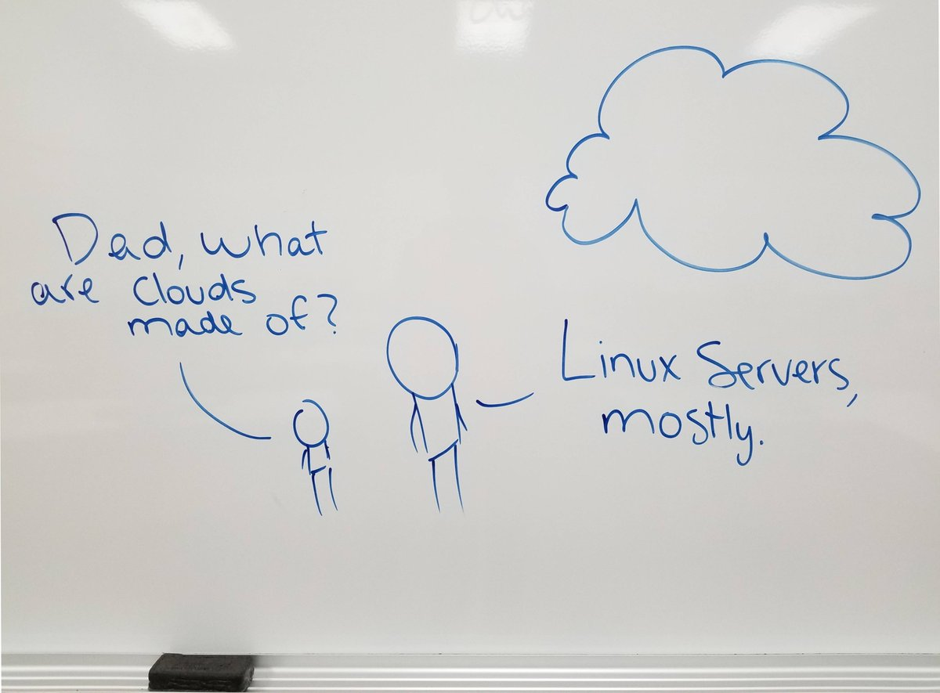
Questions?

